Slide 1

Linear Regression model
Linear regression model we use as a predictive modeling technique that allows us to build a model that can help predict continuous response value as a function of a linear combination.
Establishes a relationship between the Independent and dependent Variables.

Slide 2
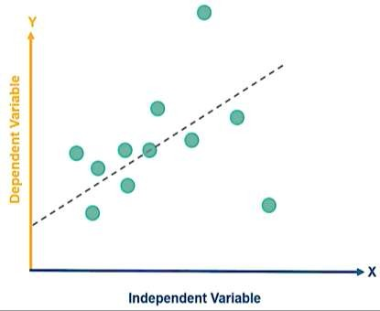
How it works
Regression analysis is used to understand which among the Independent Variables are related to Dependent Variables.
It attempts to model the relationship between two variables by fitting a line called the Linear Regression Line.
The case of a Single variable is called Simple Linear Regression whereas the case of Multiple Independent Variables, is called Multiple Linear Regression

Slide 3
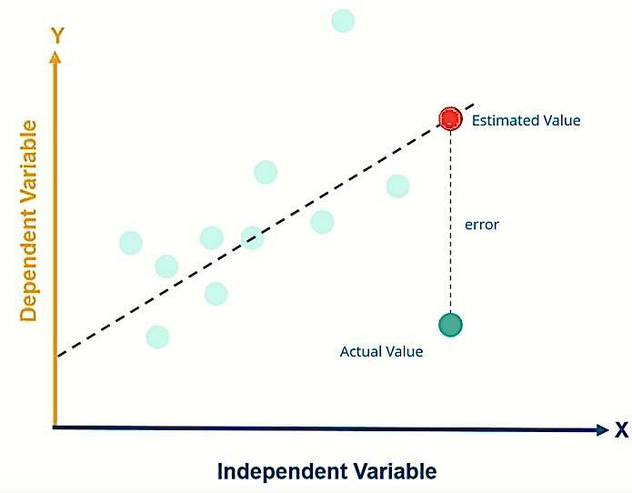
Simple Linear Regression
X Y
Multiple Linear Regression
Single Linear Regression Vs Multiple Linear Regression
X₁ X₂
X₃ X₄
Y
The Linear Regression line is created using the Ordinary Least Square Method

Slide 4



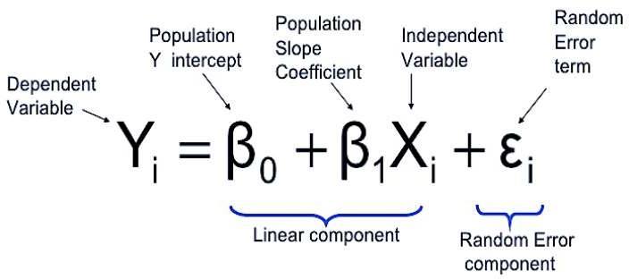
Linear Regression Equation

Slide 5
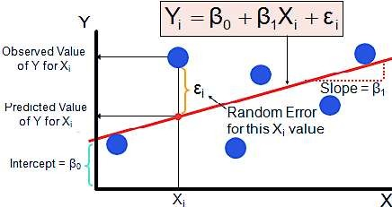
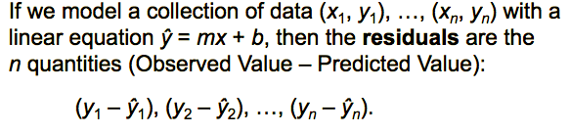
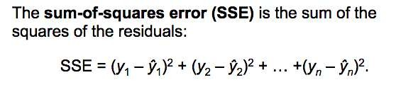
What is Error?
Actual Value – Predicted Value is called Error
Here Predicted Value is the value predicted by the Linear Regression Model.
Also known as Residual.
Why it is Important?
The smaller the residuals, the more accurate the model it would be.
Sum of Squared Error

Slide 6

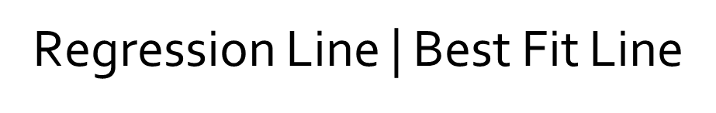
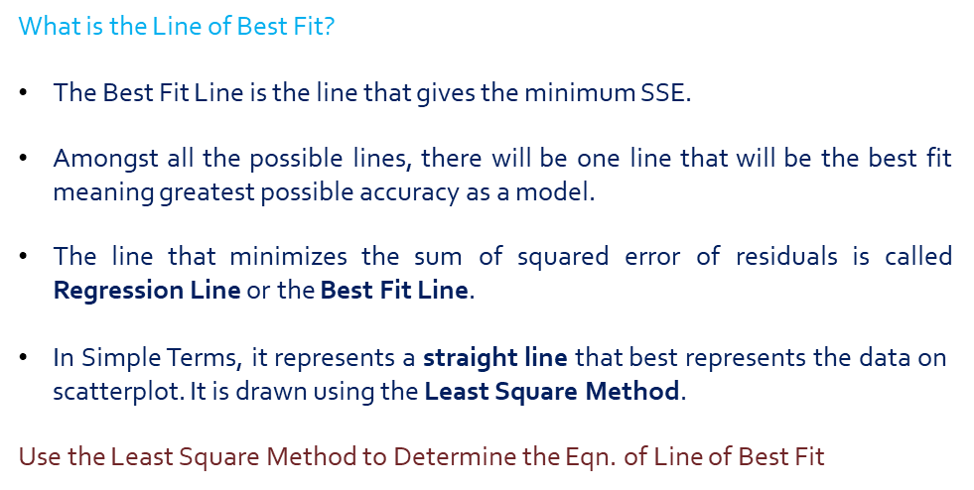
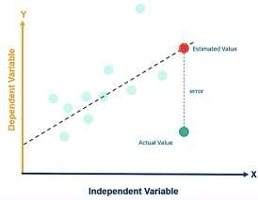
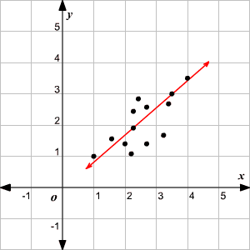
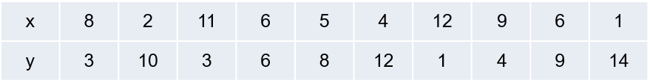

Slide 7
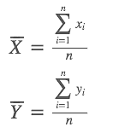
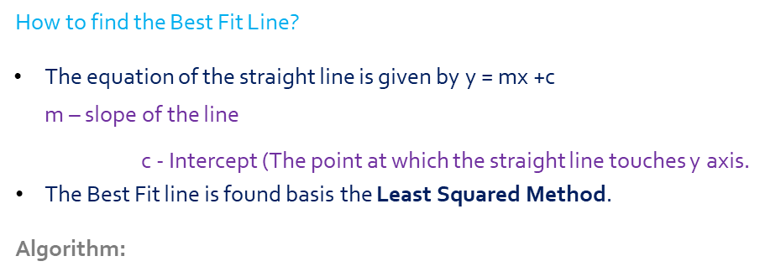
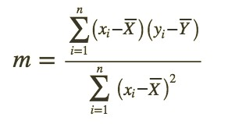
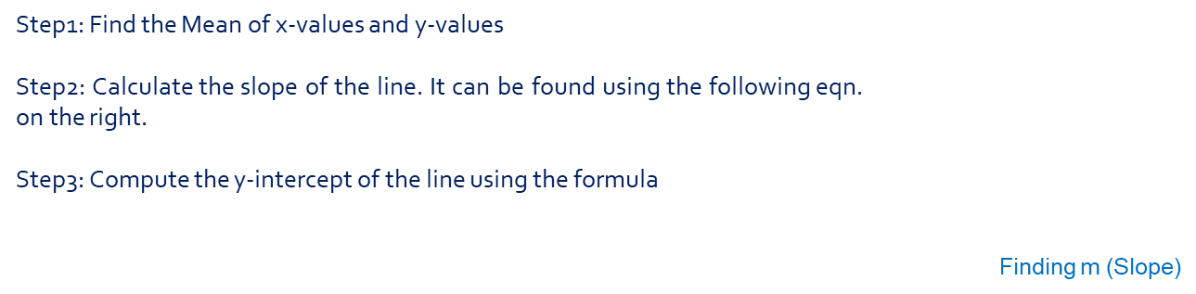

Finding Best Fit Line Algorithm
Mean of x and y values

Slide 8

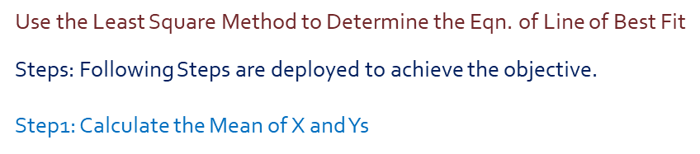


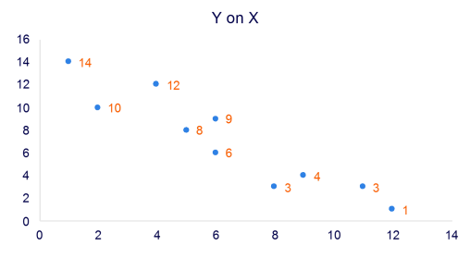
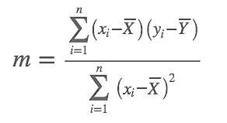

Slide 9
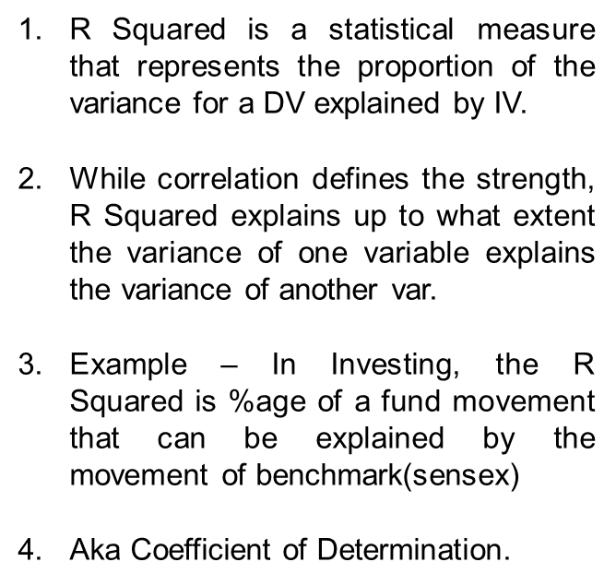
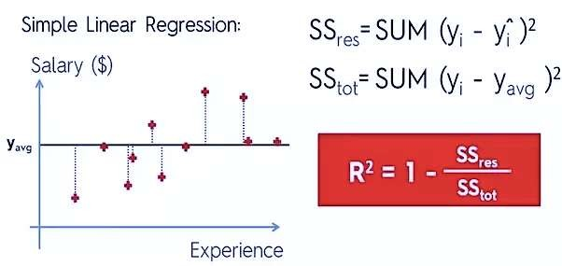
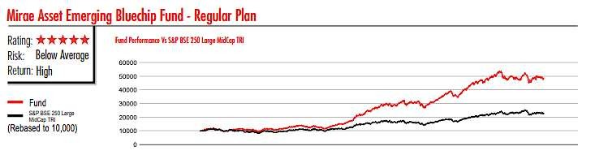
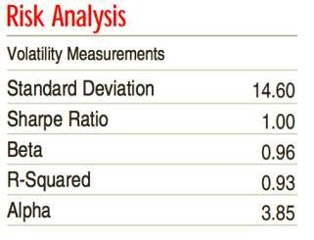

Slide 10
